Slide 1
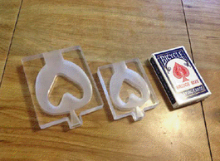
Spirometer Software
Olga Neyman
Team mates: Jessie Butts, Abby Cohen
Client: Dr. Klaesner

Slide 2
Background
Growing concern about non-communicable respiratory diseases
Chronic obstructive pulmonary disease is the only leading cause of death increasing in prevalence worldwide
Notes:
Other respiratory diseases
COPD, asthma, etc.

Slide 3
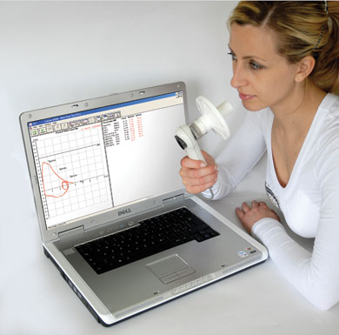
What is a Spirometer?
Device that measures the volume of air expired and/or inspired
Outputs flow-volume curve and parameters like the forced expiratory volume in 1 second and peak expiratory flow
Spirometer. (Cosmed)
Notes:
http://www.cosmed.com/index.php?option=com_content&view=article&id=257&Itemid=125&lang=en

Slide 4
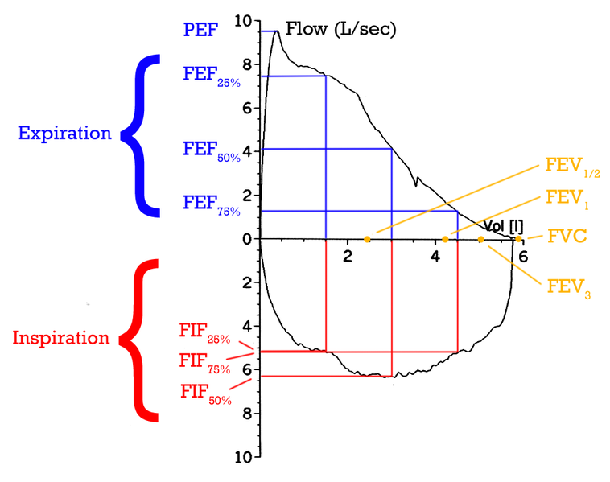
Flow-Volume Curve
₁
(Adapted from Wikipedia)
Notes:
FEV1/FVC = 75-80%

Slide 5
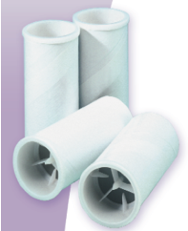
Existing Solutions
Volume-displacing Spirometers:
  Water seal spirometer
  Bellows spirometer
Flow Sensing Spirometers:
  Pneumotach spirometer
    US 5,357,972, US 2,929,248
  Thermistor spirometer
    US 4,993,269
  Turbine spirometer
    US 7,618,235
  Ultrasonic spirometer
    US 5,647,370
Adult Disposable Mouthpiece (Micro Medical, 2011)
Notes:
Commercial one

Slide 6
Need
  80% of developing countries lack access to spirometry equipment – World Health Organization
  Factors like smoking and use of biomass fuels are increasing prevalence of respiratory diseases
Notes:
Hindrances- cost, access to doctors, equipment needs to be calibrated, disposable mouthpieces

Slide 7
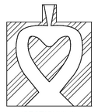
Addressing the Need
  WashU Design Team developed a low-cost spirometer
Uses a fluidic oscillator
Audible oscillations occur
Frequency of the oscillations is proportional to the velocity of the air
Low-cost spirometer

Slide 8
Existing Solutions: Non-Market Approaches
Patent on spirometer with fluidic oscillator
  Uses pressure sensors
    US 8,136,413
Patents on sensors that measure a signal from a fluidic oscillator
  Velocity, microphone, piezoelectric, piezoresistive, capacitive, optoelectric, strain-stress responsive, magnetoresistive sensors
  US 8,091,434, US 3,690,171, etc.

Slide 9
Need: The Remaining Problem
The low-cost spirometer lacks an optimized sensor and fully-functional software

Slide 10
Scope
Identify a sensor to pick up the audio signal from the fluidic oscillator
Interface the sensor between the existing hardware and a computer
Design software with a web-based user-friendly interface to read and process the audio signal
Output spirometry curves and parameters
Notes:
Process: isolate dominant frequencies, filter, perform calculations
-compare to predicted values
Make more concise
Debate further

Slide 11
Selected Design Requirements: Sensor
Specification | Desired Value
Cost | <5$
Frequency Response | 0Hz -1 kHz
Type | Noise Cancelling
Signal-to-Noise Ratio | > 60 dB
Directionality | Unidirectional
Shape | Circular
Dimensions
Diameter | 0.16 cm– 1.27 cm
Height | < 2.5 cm
Notes:
60 – common in literature
Title columns

Slide 12
Selected Design Requirements: Software: Functional
Specification | Desired Value
User access | Free access- 24/7
Required patient information | age, gender, height, ethnicity, weight
Maneuver supported | FVC and FEV1 maneuver
Display of data acceptability and data troubleshooting | Display success of maneuver
Notes:
Add accuracy

Slide 13


Selected Design Requirements: Software: Signal Processing
Specification | Desired Value
Data/Web interaction | Store and forward
File Size | 1.7 MB-17 MB
Sampling Rate | 1750 Hz
Signal processing | Noise cancelling
$$File Size=Bit Depth ×Sample Rate × Recording Length$$
$$×Number of Channels ×\frac{bytes}{8 bits} ×\frac{KB}{1024 bytes} ×\frac{MB}{1024 KB}$$
Bit Depth = 24 bits/sec
Sample Rate = 48kHz – 192kHz
Recording Length = 6-15 sec
Channels = 2
max frequency/ Nyquist = 700 Hz
To prevent aliasing:
$$2.5 ×Nyquist=1750 Hz$$
Notes:
Sample rate calculation
File size calculation
Sensor hooked t ocomputer. Computer saves at sampling rate of 48-192. Uploaded as such
File size before sample rate
Sample rate -> nyquist

Slide 14
Selected Design Requirements: Software: Results
Specification | Desired Value
Reference values | NHANES3
Values calculated from data | FVC FEV₁ FEV₆ Change between tests | Expiration time FEV₁/FVC FEV₁/FEV₆ FEF_{25-75%} FEF_{X%}
Graphs compiled from data | Flow-volume curve, Volume-time curve

Slide 15
Selected Design Requirements: Software: ATS Standards
Accuracy and Precision
Specification | Desired Value
FVC Accuracy | +-3% (+-3.5% if using a calibration syringe)
FEV₁ | +-3%
FEF_{25-75%} Accuracy | +-5%
Reproducibility | Largest FVC and FEV₁ within 150 mL of next
Notes:
ATS standards – accuracy/precision

Slide 16
Preliminary Design Schedule
Tasks | 5-Sep | 12-Sept | 19-Sept | 24-Sept | 1-Oct | 8-Oct | 15-Oct | 22-Oct | 29-Oct | 5-Nov | 12-Nov | 19-Nov | 28-Nov | 5-Dec | 11-Dec
Project Initiation
Project Selection
Define Problem
Develop Project Plan
Project Scope
Become Informed
Preliminary Oral Report
Preliminary Written Report
Create Class Webpage
Design Web App
Hardware analysis
Develop GUI
Progress Oral Report
Progress Written Report
Interface Analysis
Web App Implementation
Software troubleshooting
Final Oral Report
Final Written Report
Project Poster

Slide 17
Organization of Team Responsibilities
Jessie: Hardware
  Sensor
  Hardware /computer interface
  Final Oral Report
  Olga: Backend software development
  Analysis coding and signal processing
  Preliminary Oral Report
  Abby: Frontend development
  Server/ client interface
  Progress Oral Report

Slide 18
Works Cited
Flow-Volume-Loop. Digital image. Wikipedia. N.p., n.d. Web. 24 Sept. 2012. <http://en.wikipedia.org/wiki/File:Flow-volume-loop.png#filelinks>.
Global Status Report on Noncommunicable Diseases 2010. Geneva, World Health Organization
Micro Medical. (2007). Adult Disposable Mouthpieces. Retrieved September 19, 2012, from Micro Medical: Consumables: http://www.micromedical.co.uk/downloads/pdf/consumables.pdf
Miller, M.R. "Standardization of Spirometry." American Thoracic Society, 2005. Web. <http://www.thoracic.org/statements/resources/pfet/PFT2.pdf>.
PC Based USB Spirometer. Digital image. COSMED Pulmonary Function Equipment. N.p., n.d. Web. 24 Sept. 2012. <http://www.cosmed.com/>.

Slide 19
Questions?

