Slide 1
Progress Report
Spirometry Software
Group 36
Abby Cohen
Team mates: Jessie Butts, Olga Neyman
Client: Dr. Klaesner

Slide 2
Need
  80% of developing countries lack access to spirometry equipment – World Health Organization
  Factors like smoking and use of biomass fuels are increasing prevalence of respiratory diseases
Notes:
Hindrances- cost, access to doctors, equipment needs to be calibrated, disposable mouthpieces

Slide 3

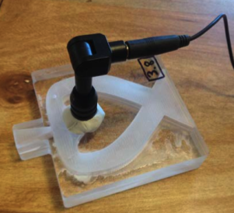
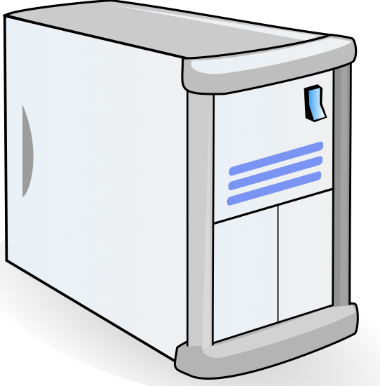
The Big Picture
Results
Record Data
Troubleshooting
Data Processing
Data Analysis
User’s Laptop
Server
Spirometer Hardware

Slide 4
Audio Sensor
 | Desired Criteria | Weight | Omnidirectional | Laptop | Unidirectional | Digital
Cost | < 5$ | 10 | 10 | 10 | 10 | 0
Frequency Response | (0-1kHz) | 10 | 9 | 9 | 9 | 9
Output Type | Analog | 10 | 10 | 10 | 10 | 0
Operating Temp | 0~40° C | 10 | 10 | 10 | 10 | 10
Signal-to-noise | > 60 dB | 8 | 10 | n/a | 10 | 9
Directionality | Unidirectional | 8 | 0 | 0 | 10 | 0
Shape | Circular | 8 | 10 | 10 | 10 | 0
Diameter | 0.16 cm– 1.27 cm | 8 | 10 | 0 | 10 | 0
Height | < 2.5 cm | 8 | 10 | 0 | 10 | 10
Impedance | < 600 Ω | 7 | 5 | n/a | 9 | n/a
Weight | < 10 g | 6 | 10 | n/a | 10 | 10
Current Supply | ≤ 500 μA | 6 | 10 | n/a | 10 | 0
Sensitivity | < -55 dB | 6 | 5 | 9 | 10 | 0
Total |  |  | 895 |  | 1033
Notes:
Limited initially… termination points, solder leads to different microphones
Correct specifications rather than just the termination point
Unidirectional-
Omnidirectional
Laptop
Digital
Omnidirection vs

Slide 5
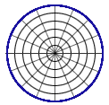
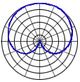
Microphone
Omnidirectional vs. Unidirectional
Omnidirectional
Unidirectional
Microphone diaphragm reaction depends of direction of sound

Slide 6
Audio Sensor
 | Desired Criteria | Weight | Omnidirectional | Laptop | Unidirectional | Digital
Cost | < 5$ | 10 | 10 | 10 | 10 | 0
Frequency Response | (0-1kHz) | 10 | 9 | 9 | 9 | 9
Output Type | Analog | 10 | 10 | 10 | 10 | 0
Operating Temp | 0~40° C | 10 | 10 | 10 | 10 | 10
Signal-to-noise | > 60 dB | 8 | 10 | n/a | 10 | 9
Directionality | Unidirectional | 8 | 0 | 0 | 10 | 0
Shape | Circular | 8 | 10 | 10 | 10 | 0
Diameter | 0.16 cm– 1.27 cm | 8 | 10 | 0 | 10 | 0
Height | < 2.5 cm | 8 | 10 | 0 | 10 | 10
Impedance | < 600 Ω | 7 | 5 | n/a | 9 | n/a
Weight | < 10 g | 6 | 10 | n/a | 10 | 10
Current Supply | ≤ 500 μA | 6 | 10 | n/a | 10 | 0
Sensitivity | < -55 dB | 6 | 5 | 9 | 10 | 0
Total |  |  | 895 |  | 1033
Notes:
Limited initially… termination points, solder leads to different microphones
Correct specifications rather than just the termination point
Unidirectional-
Omnidirectional
Laptop
Digital
Omnidirection vs

Slide 7
Noise Cancellation
Hardware Approach
 | Desired Criteria | Weight | Microphone Location | Microphone Number | Pop Filter Analog
Accuracy | +-3% | 10 | 7 | 8 | 6
Cost | <$5 | 10 | 10 | 4 | 8
Precision | +-5% | 8 | 8 | 6 | 10
Noise Reduction |  | 8 | 5 | 8 | 8
Response time for analysis | <10 seconds | 4 | 10 | 6 | 10
Totals |  |  | 314 | 292 | 324

Slide 8




Noise Cancellation
Microphone Location
Relationship between frequency
  F₁ = 2 * F₂
Analysis
  Reynold’s Number
  Boundary Layer
    Located in the obstacle valley
    Located in a side chamber

Slide 9


Noise Cancellation
Microphone Number
Differential noise cancellation
Average
Directed average
  Low flow rates
Analysis
  Microphone adapter
  Accuracy
    Average/Directed Average
    Differential Noise Cancellation

Slide 10
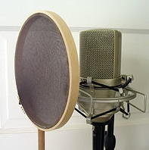
Noise Cancellation
Pop Filter
Plosives
  Max out microphone
  Buffer
Analysis
  Materials
  Degradation
    Typical Use of a Pop Filter

Slide 11
Noise Cancellation
Hardware Approach
 | Desired Criteria | Weight | Microphone Location | Microphone Number | Pop Filter Analog
Accuracy | +-3% | 10 | 7 | 8 | 6
Cost | <$5 | 10 | 10 | 4 | 8
Precision | +-5% | 8 | 8 | 6 | 10
Noise Reduction |  | 8 | 5 | 8 | 8
Response time for analysis | <10 seconds | 4 | 10 | 6 | 10
Totals |  |  | 314 | 292 | 324

Slide 12
Noise Cancellation
Software Approach
 | Desired Criteria | Weight | Window | Averaging Multiple FFT's | Moving Average Filter | Digital Low-Pass Filter | Suppression Function | Spectral Subtraction
Accuracy | ±3% | 10 | 6 | 8 | 6 | 6 | 5 | 7
Complexity | <120 seconds | 3 | 8 | 6 | 8 | 4 | 4 | 7
Noise Reduction |  | 10 | 5 | 6 | 7 | 8 | 6 | 5
Flexibility |  | 6 | 3 | 8 | 7 | 4 | 6 | 3
Totals |  |  | 151 | 197 | 197 | 171 | 153 | 148

Slide 13

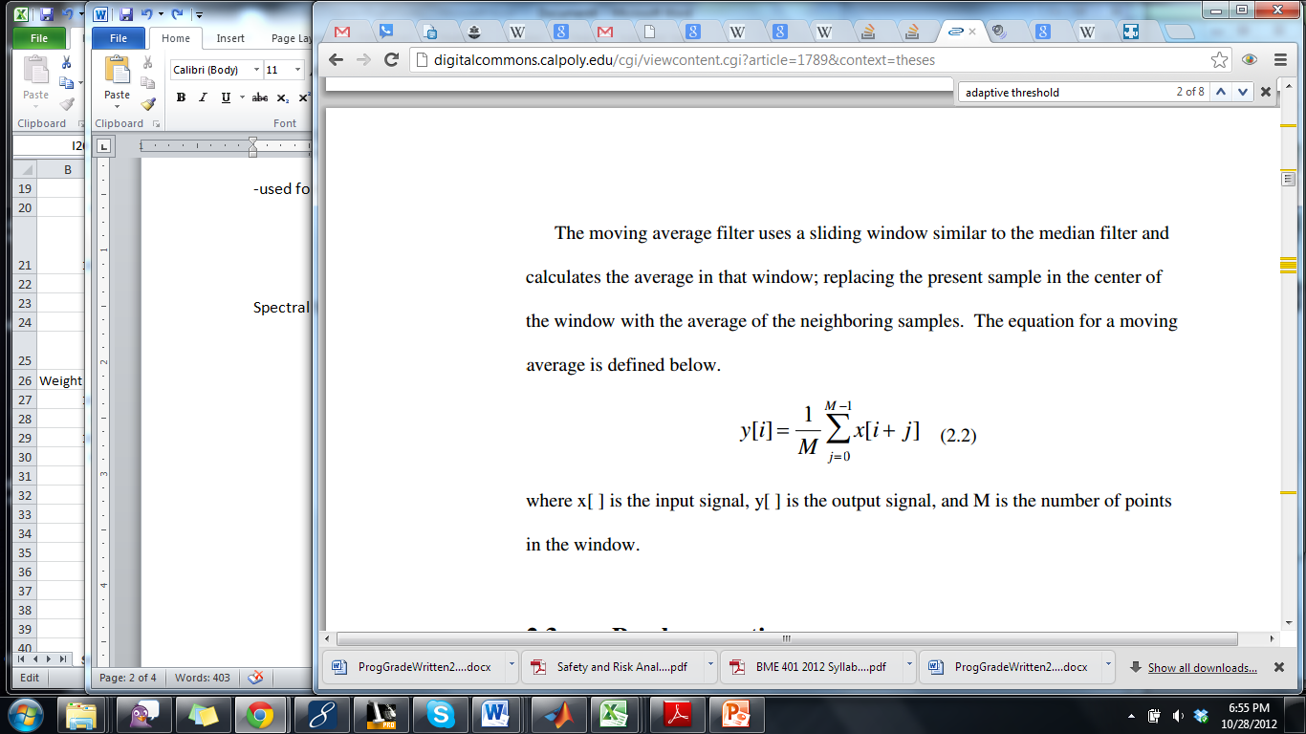
Noise Cancellation
Windowing and Filters
Hanning Window
Moving Average Filter
  Reduces effects of peaks of random noise
Low Pass Filter
  Frequencies between 0-1000 Hz
Suppression Function
  Iterative approach to noise cancellation

Slide 14
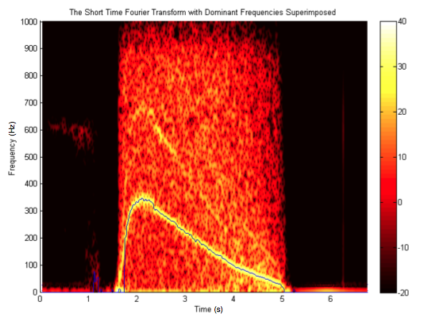
Noise Cancellation
Averaging Multiple FFTs

Slide 15
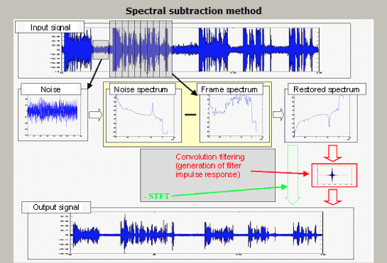
Noise Cancellation
Spectral Subtraction

Slide 16
Noise Cancellation
Software Approach
 | Desired Criteria | Weight | Window | Averaging Multiple FFT's | Moving Average Filter | Digital Low-Pass Filter | Suppression Function | Spectral Subtraction
Accuracy | ±3% | 10 | 6 | 8 | 6 | 6 | 5 | 7
Complexity | <120 seconds | 3 | 8 | 6 | 8 | 4 | 4 | 7
Noise Reduction |  | 10 | 5 | 6 | 7 | 8 | 6 | 5
Flexibility |  | 6 | 3 | 8 | 7 | 4 | 6 | 3
Totals |  |  | 151 | 197 | 197 | 171 | 153 | 148

Slide 17
Software Flow Chart
Spirometry Software
Training
Maneuver
Record Signal as WAV
Open Website
Download Recorder
Patient Info
Troubleshoot data
Data acceptability
Noise Cancellation
Filtering and Windowing
Averaging
Suppression
Predicted Values
STFT and Plot
Test Results

Slide 18
Chosen Design to Implement
Hardware
  Electret Condenser Mic (CMI-5247TF-K)
  Pop filter for Noise cancellation
Software: Java platform with JSP framework
  Downloadable component: WAV file
  Web app component
    Troubleshooting
    Noise Cancellation
      Filters
      Windowing
      Iterative approach
      Averagin
Display
  Reliability of data
  Results showing predicted values, flow volume curves and derived values

Slide 19
Updated Design Schedule
Tasks | 15-Oct | 22-Oct | 29-Oct | 5-Nov | 12-Nov | 19-Nov | 28-Nov | 5-Dec | 11-Dec
Design Safe
Progress Written Report
Progress Oral Report
Implementation of Predicted Values
Interface Creation and Implementation
Back-end Noise Cancellation
Development of Training Module
Web App Implementation
Troubleshooting Software
Final Oral Report
Final Written Report
Project Poster

Slide 20
Updated Team Responsibilities
Team Member | Jessie | Olga | Abby
Completed Responsibilities | -Sensor analysis and selection | -First iteration of back-end analysis -Preliminary Oral Report | -First iteration of downloadable component -Design of Front End
Major Concerns Moving Forward | -Miscellaneous | -Web app creation | -Back end optimization
Detail Responsibilities | -Predicted Values -Design Safe -Training | -Interfacing between client and server | -Implementation of noise cancellation

Slide 21
Questions?

