Slide 1
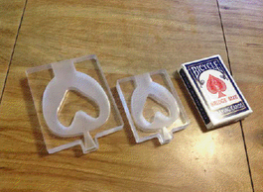
Spirometer Software
Final Report
Jessie Butts
Team mates: Olga Neyman, Abby Cohen
Group 36
Client: Dr. Klaesner

Slide 2
Background
Growing concern about non-communicable respiratory diseases
Chronic obstructive pulmonary disease is the only leading cause of death increasing in prevalence worldwide
A spirometer is a device that measures the volume of air expired and/or inspired
Notes:
Other respiratory diseases
COPD, asthma, etc.

Slide 3
Need
  80% of developing countries lack access to spirometry equipment – World Health Organization
  Factors like smoking and use of biomass fuels are increasing prevalence of respiratory diseases
Notes:
Hindrances- cost, access to doctors, equipment needs to be calibrated, disposable mouthpieces

Slide 4
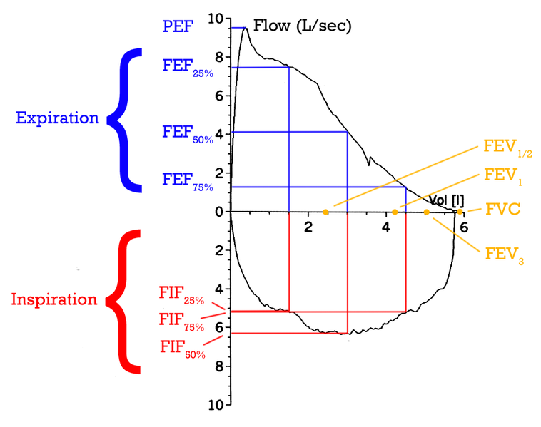
Flow-Volume Curve
₁
(Adapted from Wikipedia)
Notes:
FEV1/FVC = 75-80%

Slide 5

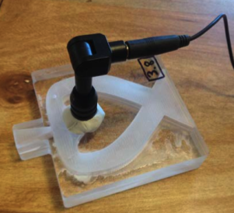
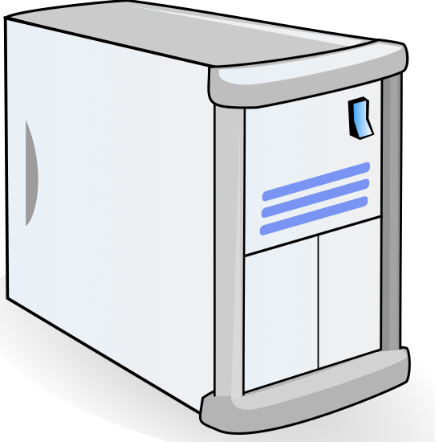
The Big Picture
Results
Record Data
Troubleshooting
Data Processing
Data Analysis
User’s Laptop
Server
Spirometer Hardware

Slide 6
Brief Signal Processing
.wav file is uploaded
File is decimated to prevent aliasing based on the Nyquist Frequency
Peaks of audio signal are found
Perform Short Time Fourier Transform (STFT)
  Low pass filter applied because upper bound of the frequency range is unknown
  High Pass filter applied such that there is a high signal-to-noise ratio present
Location of the Peak flow rates are estimated
The Flow rate is integrated to solve for the volume

Slide 7
Demonstration of Use
http://172.18.170.44:8008/spirBacJ/
Notes:
Demonstrate JSP

Slide 8
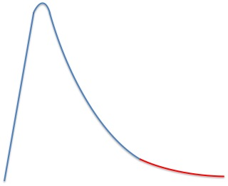
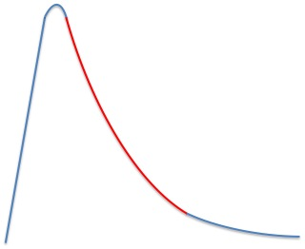
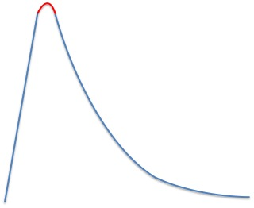
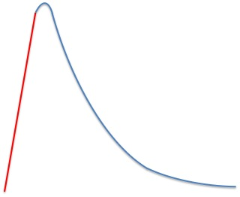
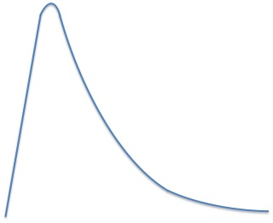
Additional Signal Processing
Short Time Fourier Transform

Slide 9
Signal Processing
Approximate initial portion as linear to eliminate plosive
Apply Moving Average
Important portion because it includes the peak
No additional noise cancelling necessary
High Signal-to-noise ratio
Apply Moving Average
Very low signal-to-noise ratio
Spectral Subtraction – Vuvuzela
Notes:
Begin MATLAB simulation
***Make sure that it is clear that a STFT is performed on the entire signal and then just a portion of each signal is used and pieced together to increase accuracy in both the time and frequency domain

Slide 10
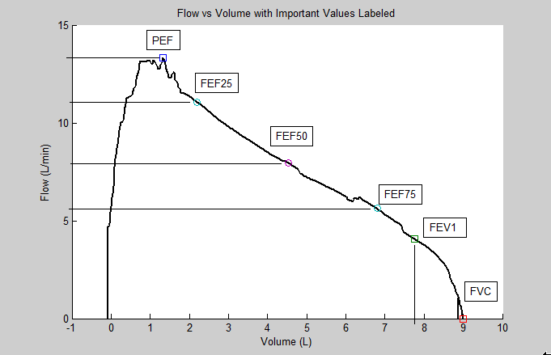
Flow Volume Values
Important Values | Predicted Value for Subject (NHANES III) | First Maneuver | Second Maneuver | Recording from and FDA approved spirometer
PEF (L/s) | 10.80 | 13.31 | 13.00 | 10.01
FEV1 (L) | 5.05 | 5.86 | 5.02 | 4.58
FVC (L) | 6.11 | 6.99 | 6.13 | 5.27
FEV1/FVC | 0.84 | 0.83 | 0.82 | 0.87
Notes:
**Potential Question: Why is Peak flow elevated
Answer: To do with hardware: too much resistance causes a larger force resulting in an erroneously high PEF
Also… look at those ratios! Bam!

Slide 11
Software Flow Chart
Audio Signal
Estimation of Maneuver Start and End
Estimation
Estimation of STFT
Plotting Curves
Optimized STFT
Calibration
Calculation of Values
Piece together optimized STFTs based on sectioning
Plotting Curves
Optimization of Maneuver Start and End
Optimization
Perform appropriate noise cancellation algorithms on 4 STFTs
Sectioning of Original Signal
Perform 4 STFTs on Signal for Accuracy Optimization
Notes:
**I would stress estimation and optimization if you do not want to go into all the detail

Slide 12
CPU Requirements
User Computer
  Windows Required (Windows 7)
    1 gigahertz (GHz) or faster 32-bit (x86) or 64-bit (x64) processor
    1 gigabyte (GB) RAM (32-bit) or 2 GB RAM (64-bit)
    16 GB available hard disk space (32-bit) or 20 GB (64-bit)
    DirectX 9 graphics device with WDDM 1.0 or higher driver
  Space for wave files
    6 sec wave file ~ 1MB x 3 trials = 3 MB
  Space for downloadable .exe component
    40.4 KB

Slide 13
CPU Requirements
Server Computer
  Tomcat 6 Apache
  Java EE 6.0
  Java Virtual Machine (For Windows 7 x64 64bit mode, 32-bit browser)
    128mb
    Browsers: Chrome, IE 7, IE 8, IE 9, Firefox3.6+, Firefox 4
  JDK 1.6.0_37 (Java Development Kit)

Slide 14
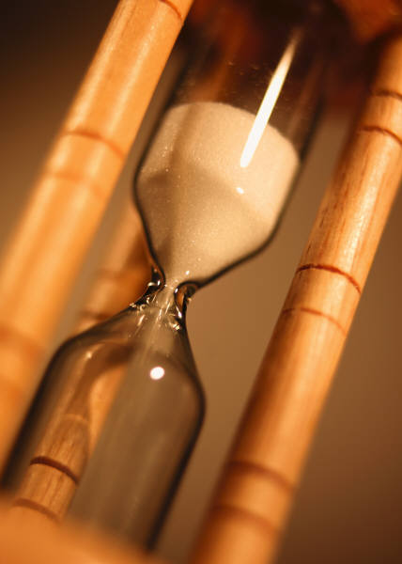
Software Run Time
Run time
JSP: 6 Sec
MATLAB: 25.1218 sec
Notes:
Calculated by time stamps

Slide 15
Software Cost
Item | Hours | Cost (at $70/hr)
Layout & Design | 10 | $700
Downloadable Component | 5 | $350
Signal Processing- JSP Version | 15 | $1050
JSP Pages | 5 | $350
Implentation of Graphics | 3 | $210
Signal Processing- Matlab Version | 20 | $1400
Future Work
Predicted Values Database Implementation | 15 | $1050
Secure Database for Patients and Doctors | 100 | $7000
Translating Matlab Processing into Java | 30 | $2100
Total | 203 | $14210

Slide 16
Hardware
Components
Microphone - CMI-5247TF-K
3.5 mm Cable - CB477-1-10
Heat Shrink - HS2-025
Wire Solder - 141786
Tools
Soldering Iron - 578-WES51
Wire Clippers - 973575000
Heat gun - HG1300
Microphone
Wire Solder
Output and V_{s}
To Computer
Audio Jack
3.5 mm cord
Ground

Slide 17
Hardware Pricing - Prototype
Component | Price | Shipping
Microphone | $2.21 | $6.73
Cable | $0.90 | $2.30
Heat Shrink | $10 | $15.00
Wire Solder | $29.95 | $7.66
Total | $43.06 | $31.69
Plus Shipping |  | $74.75
Tools | Price | Shipping
Soldering Iron | $125 | $9.23
Wire Cutters | $23.99 | $5.99
Heat Gun | $29.97 | $5.99
Total | $179 | $21.21
Plus Shipping |  | $200
Total Prototyping Cost | $274.92

Slide 18
Hardware Pricing – 10,000 Units
Component | Quantity | Unit Price | Extended Price | Shipping | Shipping per unit
Microphone | 10000 | $0.88 | $8,827.00 | $500.00 | $0.05
Cable | 10,000 | $0.32 | $3,150.00 | $404.96 | $0.04
Heat Shrink | 1000 ft | $0.02 | $192.44 | $19.50 | $0.00
Wire Solder | 10,000 | $0.03 | $279.50 | $13.30 | $0.00
Assembly |  | $0.60 | $6,000.00 | N/A | N/A
Total |  | $1.84 | $18,448.94 | $937.76 | $0.09
Plus Shipping |  | $1.94 | $18,449.03
Price Per Unit | $1.94

Slide 19
Intellectual Property
Submitted a provisional patent
Covers signal processing
Novel Aspects:
  Approaching noise cancellation of an audio signal through estimation of the signal itself
  Applying STFT parameters and noise cancellation algorithms based on the flow rate and signal to noise ratio present in a single signal
  Performing multiple STFTs and utilizing information from all as a noise cancellation approach

Slide 20
Future Directions
Competitions
  Discovery Competition
  Olin Cup Finalists- Business Plan
Software development
  Optimization of all the different components
  Integration of the components
Hardware development
  Altering Hardware Prototype
  Ergonomics of Prototype
Development of project into a viable, marketable product

Slide 21
Conclusion
Problem Solved?
  Problem was solved yet all of the goals were not met.
  What needs to get done:
    Integration of MATLAB processing into the JSP
    Implementation of Predicted values
    Built in Trouble Shooting

Slide 22
Conclusion
What did we learn?
  Olga and Abby greatly improved their coding skills
  Jessie increased understanding of audio recording and microphone circuitry
  We all learned the strengths and weaknesses of our group members and how to work better together

Slide 23
Questions?

